Slide 1









Connect
Women’s Centres
The Provincial Association of Women’s Resource Centres

Slide 2

Women’s Centres
Community Services
Health
Justice
Education
One Door, Any Reason
Women’s Centres
Community Wrap Around Services…..
…Along the Social Determinants Continuum of Care

Slide 3

Women’s Centres
Any Door, Any Reason
Information & Referrals
Support Counselling and Crisis Intervention
Advocacy and Accompaniment
Legal Information
Primary Health Care
Financial/ Employment
Addictions
Mental Health
1-1 Counselling
Crisis Intervention
Drop In
Support Groups
Court/Medical/Education
All Systems Navigation
Advocacy around SD
Acute, Urgent, Preventative & Educational Services

Slide 4




Reclaiming Power and Place (June 30, 2019).
Nova Scotia’s Equity and Anti-Racism Strategy (NS EAR) (July 2023).
National Action Plan on Violence Against Women and Gender-Based Violence (NAP) (November 9, 2022).
Mass Casualty Commission (MCC) (March 2023).
Report of the inquiry following the deaths of Corporal Lionel.

Slide 5

Why? Inspire Action and Change
To make the wisdom insights and opportunities outlined within and across the five reports accessible.
Enhance service delivery, improve information management and leadership strategies to increase sector well-being and capacity, and leverage opportunities for collective, front-line influence.
Encourage and empower the development of a Centre or community-level response or work plans.

Slide 6

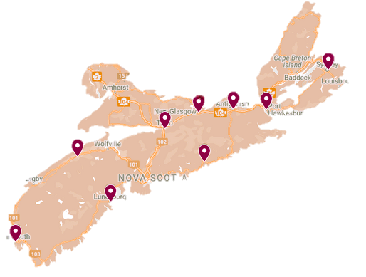
200+ GBV Prevention Actions are taking place in (just) 9 Women’s Centres

Slide 7

Across Reports
Prioritize survivors’ needs.
1
Coordinate interventions across health, justice, social services, and community sectors, especially in marginalized communities.
Youth involvement, education and engagement.
8
2
Summary of Calls to Actions
Continuous policy development.
7
3
Address the systemic roots of GBV
Collaboration across sectors
6
4
Sustainable funding
5
Enhanced data collection

Slide 8
PRIMARY PREVENTION AND UPSTREAM
INTERVENTIONS
Declaring GBV as an epidemic through the Municipal councils.
Increasing funding towards specialized organizations for training professionals, rural-targeted approaches.
Engaging men and boys to support them in expressing their emotions.
Incorporating population health approaches.
Coordinated whole society approach by working with advocacy groups and schools.
MORPH intervention programs to address root causes to prevent escalation.
Prevention education through public awareness campaigns.

Slide 9
Supporting The Intersectional Needs Of Diverse Communities And Populations
Embedding an EDI
Identify and prioritize underserved communities
Capacity building through staff and volunteer training, engaging in a 10-module Equitability training.
Development of an Anti-Black Racism Policy.
Increasing Accessibility of Services; offer weekly and bi-weekly outreach in rural communities.
Community engagement and relationship building by supporting peer programming for parents of trans kids.

Slide 10

CHILDREN, YOUTH, AND FAMILIES AS POPULATIONS
Creation of Policy updates with a child and Family-Centered Lens.
Funding and Sustainability for Family-Oriented Programs; Joint grants for sexual health supplies and emergency food aid.
Advocacy and Systemic Engagement. Improving service delivery for children and families impacted by GBV and engagement in cross-sector advocacy groups.
Whole-family approaches like client navigation services i.e. mothers or guardians, and food security nutrition programs
Investing in community-based outreach strategies across diverse family systems and rural communities.
Youth-centered educational resilience programs; partnering with schools to encourage the youth to express themselves in healthy ways.

Slide 11


Challenging Gender Norms. Partnering with local Family Resource Centres to develop programs dismantling traditional gender roles.
In-school programming delivered a “building resilience” program to all-gender youth, fostering emotional expression and connection through creative activities.
Engagement of Men and Boys. Delivering workshops and training directly addressing sexual violence, addictions, grief, and trauma experienced by men and boys.
Whole-family approaches like client navigation services such as mothers or guardians.
MEN & BOYS

Slide 12
New centralized data collection software & Data dashboards
Ongoing Policy Evaluation and Development: continuously review and update GBV policies.
Assess Resource Allocation and Service Gaps. Collect data on barriers to access.
Identify needs for operational and staffing support to enhance program delivery.
Monitoring Effectiveness of Education and Prevention Campaigns. Gather feedback from participants in professional training events.
EVALUATION, MONITORING AND DATA COLLECTION

Slide 13

“Our hope is that these reports honour the wisdom in the five synthesized reports and offers ideas for immediate action that can be taken by front staff and community organizations.”
Thank you

